Slide 1
PHP : File Upload

Slide 2
Who should be allowed up upload?
Authenticated users?
Registered users?
Valid email?
Anyone?
Generally not a good idea
Bots?
CAPTCHA? reCaptcha?

Slide 3
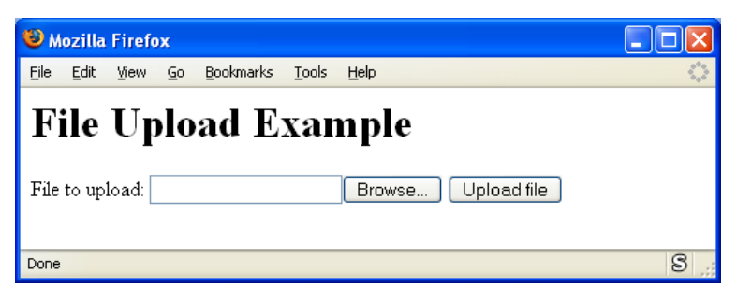
File Upload

Slide 4
File Upload
Value | Description
application/x-www-form-urlencoded | Default. All characters are encoded before sent (spaces are converted to "+" symbols, and special characters are converted to ASCII HEX values)
multipart/form-data | No characters are encoded. This value is required when you are using forms that have a file upload control
text/plain | Spaces are converted to "+" symbols, but no special characters are encoded
<html>
<body>
<h1>File Upload Example</h1>
<form enctype="multipart/form-data"
action="fileup1.php" method="post">
File to upload:&nbsp;
<input name="upfile" type="file">
<input type="submit" value="Upload file">
</form>
</body>
</html>

Slide 5
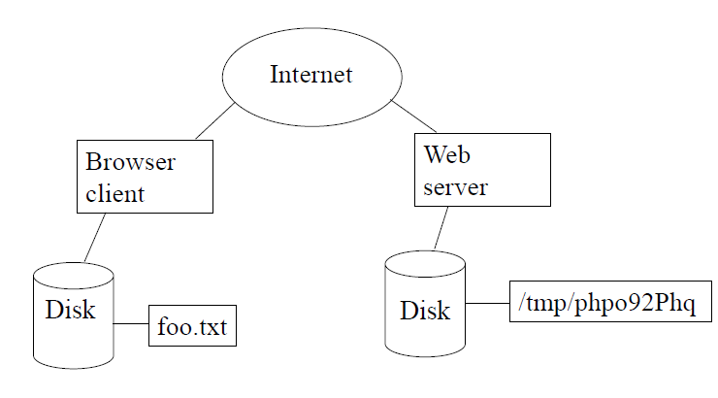
File Upload
upfile

Slide 6
$_FILES superglobal
Stores information about uploaded file
Multidimensional associative array
Uses name from HTML form:
<input name="upfile" type="file">
Name, tmp name on server, size, type, error
$_FILES['upfile']['size']

Slide 7
$_FILES superglobal
By using the global PHP $_FILES array you can upload files from a client computer to the remote server.
The first parameter is the form's input name and the second index can be either "name", "type", "size", "tmp_name" or "error". Like this:
$_FILES["file"]["name"] - the name of the uploaded file
$_FILES["file"]["type"] - the type of the uploaded file
$_FILES["file"]["size"] - the size in bytes of the uploaded file
$_FILES["file"]["tmp_name"] - the name of the temporary copy of the file stored on the server
$_FILES["file"]["error"] - the error code resulting from the file upload

Slide 8
Fileup1.php
<h1>Uploaded file information</h1>
<?php
echo "<br>user's file name: " . $_FILES['upfile']['name'];
echo "<br>tmp name on server: " . $_FILES['upfile']['tmp_name'];
echo "<br>size: " . $_FILES['upfile']['size'];
echo "<br>type: " . $_FILES['upfile']['type'];
echo "<br>error: " . $_FILES['upfile']['error'];
echo "<br>contents:";
echo "<br><pre>";
$contents =
strip_tags(file_get_contents($_FILES['upfile']['tmp_name']));
echo $contents;
echo "</pre>";
?>

Slide 9
Error Checking & Security
Check for file upload errors
Check the file type (error, not security)
Verify that file was uploaded
Move/Rename the file if storing it
Name should include rand #, date
Clean the contents (if displaying)
strip_tags
htmlentities
NOTE: If you don't move the file, it will be deleted!!!

Slide 10
Random numbers and Dates
<?php
$r = rand();
$d = date("dmY-His");
$fn = 'upfile-' . $d . '-' . $r . '.txt';
echo "filename = " . $fn;
?>
Example Output:
filename = upfile-20022007-145438-811123264.txt

Slide 11
Error Checking and Security
<h1>Uploaded file information</h1>
<?php
if ($_FILES['upfile']['error'] > 0) {
echo "Error uploading file.";
exit;
}
if ($_FILES['upfile']['type'] != 'text/plain') {
echo "Not a text file.";
exit;
}
$upfile = '/tmp/upfile-' . date("U") . '-' . rand() . '.txt';
if (is_uploaded_file($_FILES['upfile']['tmp_name'])) {
if (!move_uploaded_file($_FILES['upfile']['tmp_name'], $upfile)) {
echo "Error moving file";
exit;
}
Continued………
Check if there actually exists a file
Copy uploaded temporary file as a properly named file

Slide 12
Error Checking and Security
Continued………
chmod($upfile, 0644); // Read, Write for Owner, Read for everyone else
} else {
echo "Possible file upload attack";
exit;
}
echo "File uploaded okay.";
echo "<br>Contents:";
echo "<br><pre>";
$contents = file_get_contents($upfile);
$contents = htmlentities(strip_tags($contents));
echo $contents;
echo "</pre>";
?>

Slide 13
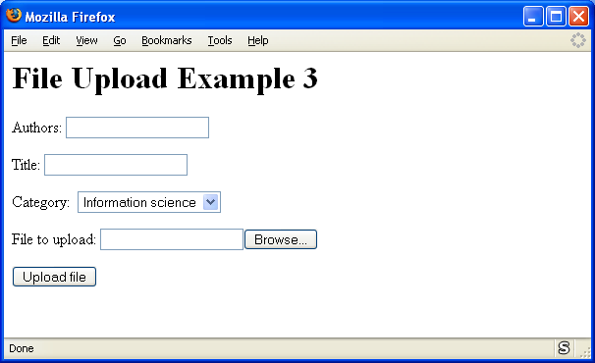
File upload with other form data

Slide 14
File upload with other form data
<html>
<body>
<h1>File Upload Example 3</h1>
<form enctype="multipart/form-data" action="fileup3.php" method="post">
<p>Authors:&nbsp;<input name="authors" type="text">
<p>Title:&nbsp;<input name=“title" type="text">
<p>Category:&nbsp;
<select size="1" name="category">
<option>Information science</option>
<option>Library science</option>
</select>
<p>File to upload:&nbsp;<input name="upfile" type="file">
<p><input type="submit" value="Upload file">
</form>
</body>
</html>

Slide 15
File upload with other form data
<h1>Uploaded file information</h1>
<?php
if ($_FILES['upfile']['error'] > 0) {
echo "Error uploading file.";
exit;
}
if ($_FILES['upfile']['type'] != 'application/pdf') {
echo "Not a PDF file."; exit;
}
$uppath = '/export/home/nust/mcs/public_html/uploads';
$upname = 'upfile-' . date("U") . '-' . rand() . '.pdf';
$upfile = $uppath . '/' . $upname;
if (is_uploaded_file($_FILES['upfile']['tmp_name'])) {
if (!move_uploaded_file($_FILES['upfile']['tmp_name'], $upfile)) {
echo "Error moving file“;
exit;
}
} else {
echo "Possible file upload attack";
exit;
}
Continued…..

Slide 16
File upload with other form data
Continued…..
$authors = htmlentities(strip_tags($_POST['authors']));
$title = htmlentities(strip_tags($_POST['title']));
$category = htmlentities(strip_tags($_POST['category']));
echo "File uploaded okay.";
echo "<br>Authors: $authors <br>Title: $title <br>Category: $category";
echo "<br>Link to uploaded file:";
echo '<a href="http://nust.edu.pk/nust/mcs/uploads/' . $upname . '">pdf</a>';
?>

Slide 17
Model-View-Controller Framework

Slide 18
What is a Framework?
A framework is designed to support the development of dynamic websites and Web applications.
Aims
Improve productivity
Promote code reuse
Minimize errors
Reduce cost of maintenance

Slide 19
Why use it?
Out of the box Functionalities
A framework normally provides many prebuilt functions and methods
Avoid “plumbing” code
Can customize and extend
Numerous integration points
Interfaces and small methods give more control
It keeps up with trends and APIs
Compatibility with diverse database systems, authentication and other APIs
Web services

Slide 20
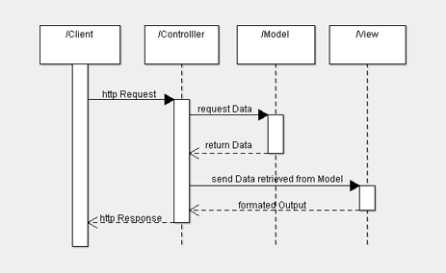
PHP & MVC

Slide 21
Model View Controller (MVC)
The model view controller pattern is the most used pattern for today’s world web applications
It has been used for the first time in Smalltalk and then adopted and popularized by Java
At present there are more than a dozen PHP web frameworks based on MVC pattern

Slide 22
Model View Controller (MVC)
The model is responsible to manage the data
The view (presentation) is responsible to display the data provided by the model in a specific format
The controller handles the model and view layers to work together

Slide 23
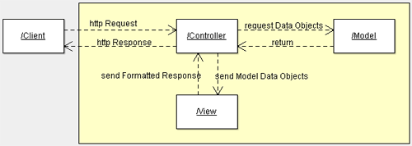
Model View Controller (MVC)

Slide 24
The Model
In MVC, the model is the code that carries out some task.
It is built with no necessary concern for how it will "look and feel" when presented to the user.
A model is an object representing data or even activity, e.g. a database table or even some plant-floor production-machine process.
The model
manages the behavior and data of the application domain,
responds to requests for data about its state and
responds to instructions to change state (of data).

Slide 25
The Model
The model often represents enterprise data and the domain rules that govern access to and updates of this data.
Often the model serves as a software approximation to a real-world process, so simple real-world modeling techniques apply when defining the model.
The model is the piece that represents the state and low-level behavior of the component. It manages the state and conducts all transformations on that state.

Slide 26
The Model
The model has no specific knowledge of either
its controllers or
its views.
However, a model must be able to "register" views and it must be able to "notify" all of its registered views when any of its functions cause its state to be changed.
The system itself maintains links between model and views and notifies the views when the model changes state. The view is the piece that manages the visual display of the state represented by the model.
A model can be associated with more than one view.

Slide 27
The Model
Note that the model may not necessarily have a persistent data store (database)
It has a purely functional interface, meaning that it has a set of public functions that can be used to achieve all of its functionality.
Some of the functions are query methods that permit a "user" to get information about the current state of the model. Others are mutator methods that permit the state to be modified.
Query
setTemperature(temp) and getTemperature() – Temperature Model
Mutator
addItem(item, category), setScore(item, student, score)… - Gradebook

Slide 28
model/Book.php
Define a class that represents a Book
<?php
class Book {
public $title;
public $author;
public $description;
public function __construct($title, $author, $description)
{
$this->title = $title;
$this->author = $author;
$this->description = $description;
}
}
?>

Slide 29
model/Model.php
Include complete code of Book.php
<?php
include_once("model/Book.php");
class Model {
public function getBookList()
{
// here goes some hardcoded values to simulate the database
return array("Jungle Book" => new Book("Jungle Book", "R. Kipling", “A classic book."),
"Moonwalker" => new Book("Moonwalker", "J. Walker", ""),
"PHP" => new Book("PHP", “Pearson", "")
);
}
public function getBook($title)
{
// we use the previous function to get all the books
// and then we return the requested one.
// in a real life scenario this will be done through
// a database select command
$allBooks = $this->getBookList();
return $allBooks[$title];
}
}
?>
Function to return a list of books
Function to return a specific book

Slide 30
What is View?
View renders the contents of a model
Its accesses enterprise data through the model and specifies how that data should be presented.
It is the view responsibility to maintain consistency in its presentation when the model changes.

Slide 31
View
A view is some form of visualization of the state of the model.
The view manages the graphical and/or textual output to the portion of the bitmapped display that is allocated to its application.
The view is responsible for mapping graphics onto a device. A view typically has a one to one correspondence with a display surface and knows how to render to it.
A view attaches to a model and renders its contents to the display surface.

Slide 32
View
A model in MVC can have several views. For examples
the rows and columns view of a spreadsheet and
the pie chart view of some column in the same spreadsheet.
A view provides graphical user interface (GUI) components for a model. It gets the values that it displays by querying the model of which it is a view.
When a user manipulates a view of a model, the view informs a controller of the desired change.

Slide 33
view/viewbook.php
<html>
<head></head>
<body>
<?php
echo 'Title:' . $book->title . '<br/>';
echo 'Author:' . $book->author . '<br/>';
echo 'Description:' . $book->description . '<br/>';
?>
</body>
</html>
We will see after a few slides how do we link a Model with a View

Slide 34
view/booklist.php
<html>
<head></head>
<body>
<table>
<tbody>
<tr><td>Title</td><td>Author</td><td>Description</td></tr>
</tbody>
<?php
foreach ($books as $book) {
echo '<tr><td><a href="index.php?book=' .
$book->title . '">' . $book->title . '</a></td><td>' .
$book->author . '</td><td>' . $book->description . '</td></tr>';
}
?>
</table>
</body>
</html>

Slide 35
Controllers
The controller handles the model and view layers to work together. The controller receives a request from the client, invokes the model to perform the requested operations and sends the data to the View. The view formats the data to be presented to the user, in a web application as an html output
Views in MVC are associated with controllers that update the model as necessary when a user interacts with an associated view.
The controller can call mutator methods of the model to get it to update its state.
The model will notify ALL registered views that a change has been made and so they will update what they display to the user as appropriate

Slide 36
Controllers
A controller offers facilities to change the state of the model. The controller interprets the mouse and keyboard inputs from the user, commanding the model and/or the view to change as appropriate.
A controller is the means by which the user interacts with the application. A controller accepts input from the user and instructs the model and view to perform actions based on that input. In effect, the controller is responsible for mapping end-user action to application response.

Slide 37
Controllers
The controller translates interactions with the view into actions to be performed by the model. In a stand-alone GUI client, user interactions could be button clicks or menu selections, whereas in a Web application they appear as HTTP GET and POST requests.
The actions performed by the model include activating business processes or changing the state of the model.

Slide 38
Controllers
Based on the user interactions and the outcome of the model actions, the controller responds by selecting an appropriate view.
The controller is the piece that manages user interaction with the model. It provides the mechanism by which changes are made to the state of the model.

Slide 39
controller/Controller.php
<?php
include_once("model/Model.php");
class Controller {
public $model;
public function __construct(){
$this->model = new Model();
}
public function invoke(){
if (!isset($_GET['book'])) {
// no special book is requested, we'll show a list of all available books
$books = $this->model->getBookList();
include 'view/booklist.php';
}
else{
// show the requested book
$book = $this->model->getBook($_GET['book']);
include 'view/viewbook.php';
}
}
}
?>
Include Model.php to access data
Instantiate class Model
Check if user entered a name of a book to search
Get list of all books using method defined in Model Class
Display the list of books using View we defined earlier
If user has specified a book, get the details using the Model Class
Display the details using View we defined earlier

Slide 40
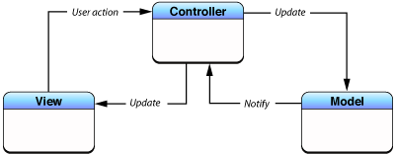
MVC Program Flow

Slide 41
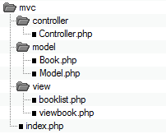
PHP & MVC

Slide 42
Advantages
Multiple view using the same model: the separation of model and view allows multiple views (Web, Mobile etc) to use the same enterprise model.
Clear separation between presentation logic and business logic so easy to maintain the code and future improvements.
Allows parallel development of different components by many developers.

Slide 43
Some Examples of PHP MVC Framework
Zend Framework An open-source PHP 5-based framework featuring an MVC.
CodeIgniter A simple, light, fast, open source MVC framework for building websites using PHP.
Joomla v1.5.x is an open source content management system that employs the MVC model.
Symfony Framework A PHP 5 MVC framework.

Slide 44
What is Zend Framework?
An open source, MVC-based PHP framework
Components developed, tested, distributed together
But loosely coupled
“Use at will” architecture

Slide 45
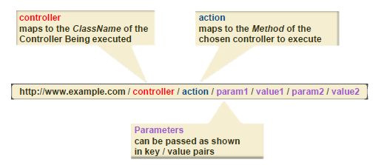
How is MVC Mapped to the Web?
To implement MVC on the web, URLs must be mapped to Controllers
Zend Framework uses the following approach…

